Slide 1


Step 1:
Assessment—Developing a Shared Understanding of the Organization’s Environment

Slide 2
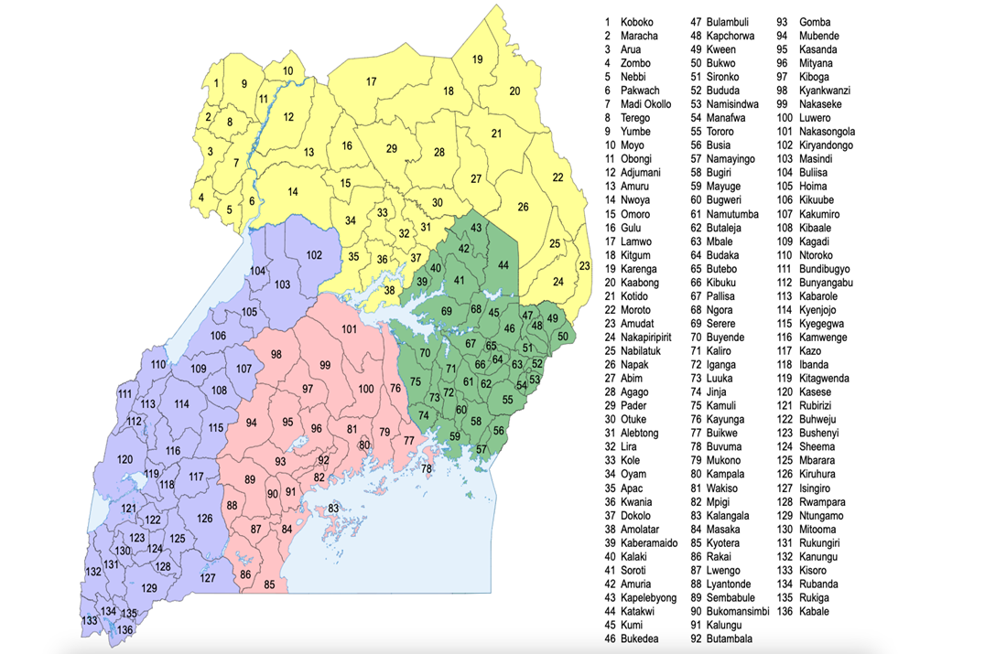

Slide 3
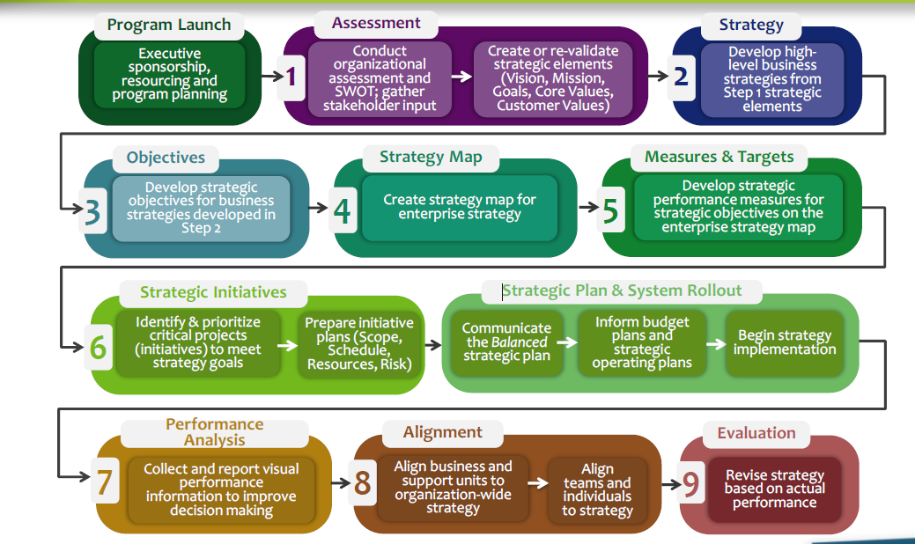
The Nine Steps to Success Framework

Slide 4

Step One: Assessment
Learning Objectives
  Understand how to conduct a Balanced Scorecard (BSC) Assessment
  Develop and validate Mission, Vision, Core Values, Customers and Stakeholders Identified, and Organization Enablers and Pains

Slide 5
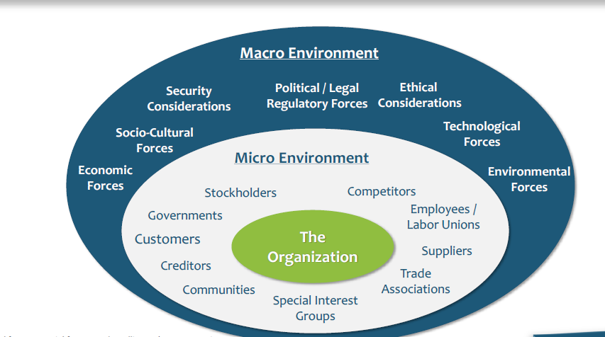
Assessment Means Understanding the
Organization’s Environment

Slide 6
Step One Tasks:
Review Existing High Level Strategic Elements
Conduct an Environmental Scan
Develop or Revalidate High Level Strategic Elements

Slide 7
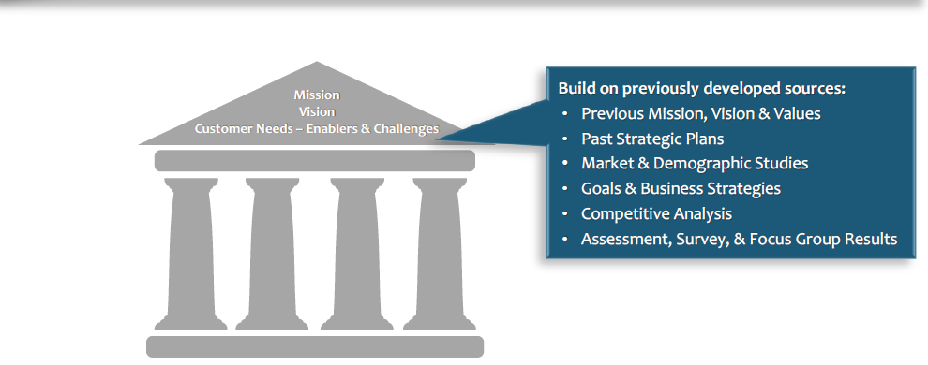
Task 1: Review Existing High Level Strategic Elements

Slide 8
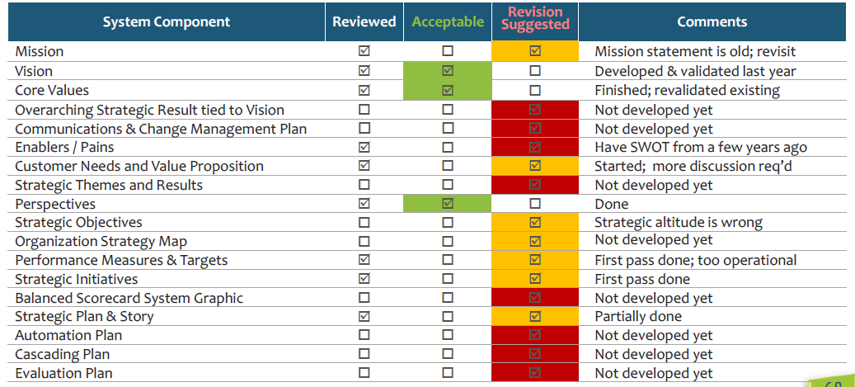
Review & Critique Existing Components

Slide 9
The internal analysis focuses on:
Culture and performance
Capability for strategic thinking and action
Internal stakeholder groups and their positions
Core competencies and strengths, as well as weaknesses
Communication clarity (or lack thereof)
Employees’ capabilities and capacities

Slide 10
The external analysis focuses on:
The macro view, including political, economic, regulatory and demographic trends and forces
Trends and forces in the organization’s particular industry and market
Customers’ and stakeholders’ identities and needs

Slide 11
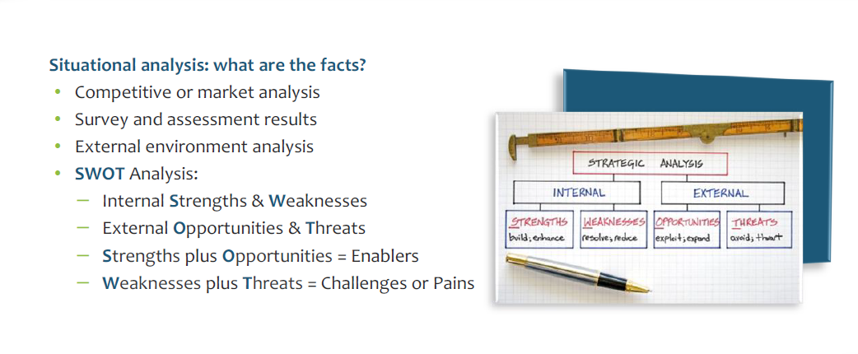
Task 2: Conduct an Environmental Scan

Slide 12
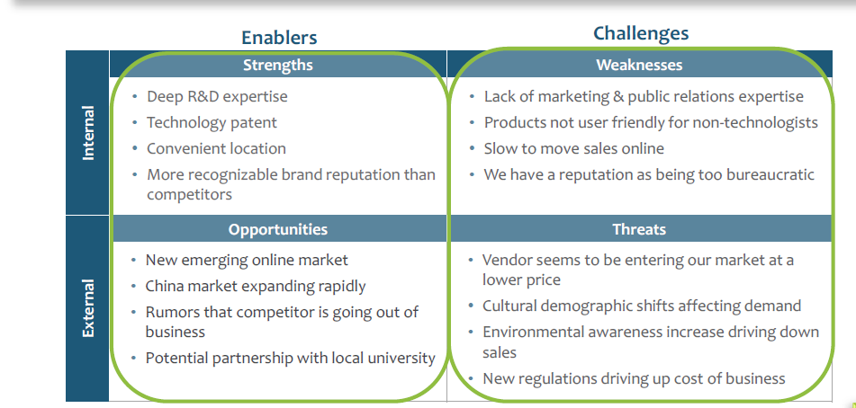
Summarize SWOT and Other Strategic Assumptions as Enablers & Challenges

Slide 13
Task 3: Develop or Revalidate High-level Strategic Elements Characteristics Of Good Mission, Vision & Core Values
Vision
Describes where we want our organization to be in 3 -10 years, our picture of the future – “Our Vision is to become (achieve) …”
Brief, easy to understand and communicate message, usually one sentence
Vision statement should be emotionally inspiring
Mission
Who we are, what we are about, or our purpose – “Our Mission is to provide (serve) …”
A few sentences in length – no more than one paragraph
Often incorporates features of our organization (e.g., products or services, markets or community served, functions performed, uniqueness)
Core Values
Describes what we stand for in the context of the organization’s mission. Defines our code of conduct, expected behavior
Provides ethical guidelines for decision-making and daily conduct (e.g., hiring, promoting, relationship building)

Slide 14
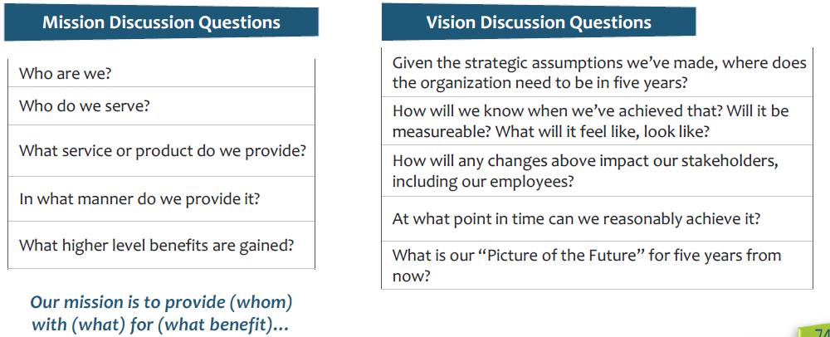
How to Develop a Shared Understanding of an Organization’s Mission and Vision

Slide 15
What to avoid during Assessment Step
Not taking time to fully understand who the customer is
Using “weasel” words-words that aren’t specific-too much industry jargon or vague sentiments that have no defined meaning
Deploying too many lists and too little analysis (SWOT Analysis)
Ignoring previous planning and assessment efforts.
Too much “wordsmithing” on mission and vision statements
Not fully engaging employees and external stakeholders in assessment
Not being transparent

Slide 16
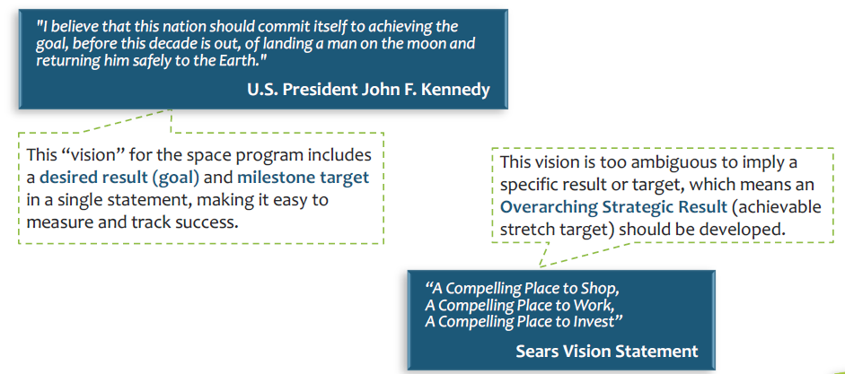
An Overarching Strategic Result (Goal, Target or Strategic Destination) Can Make a Vision Statement Measurable

Slide 17

Thank You
Questions

