Slide 1
  INSTITUTIONAL QUESTIONNAIRE
  NPHC 2024 TRAINING

Slide 2
OUTLINE
Launch the Institutional Questionnaire Module
The Institutional Questionnaire Interview
Add new institution or Modify an existing institution

Slide 3
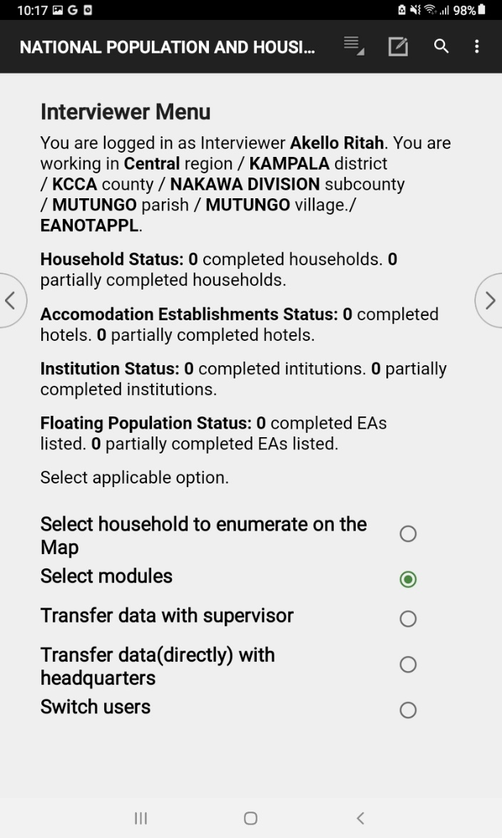
Institutional Questionnaire Module (1/2)
Tap “Select Modules” on the Interview Menu screen

Slide 4
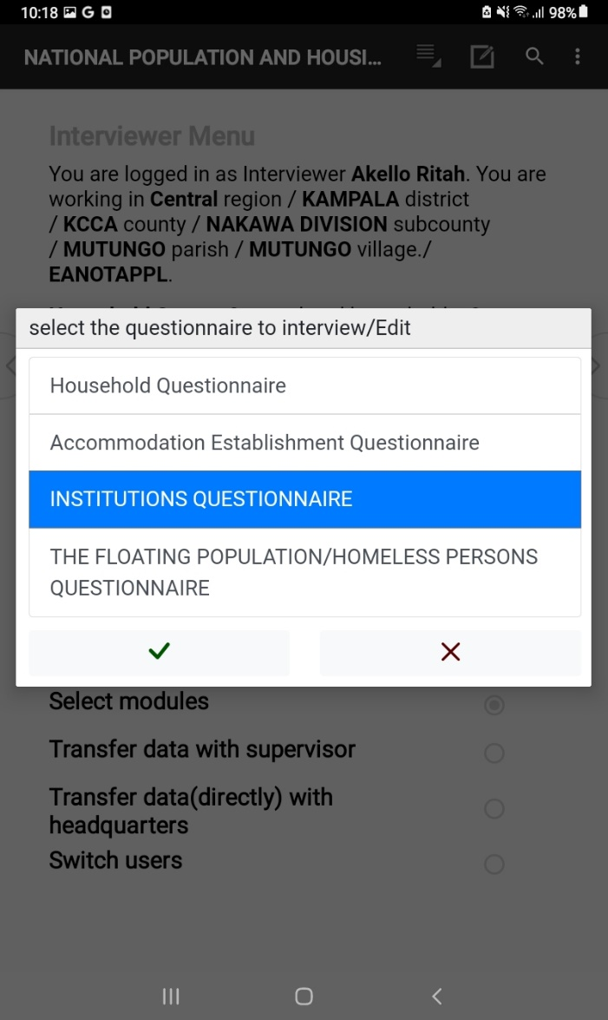
Institutional Questionnaire Module(2/2)
Tap the “Institutional Questionnaire”
Tap the tick icon

Slide 5
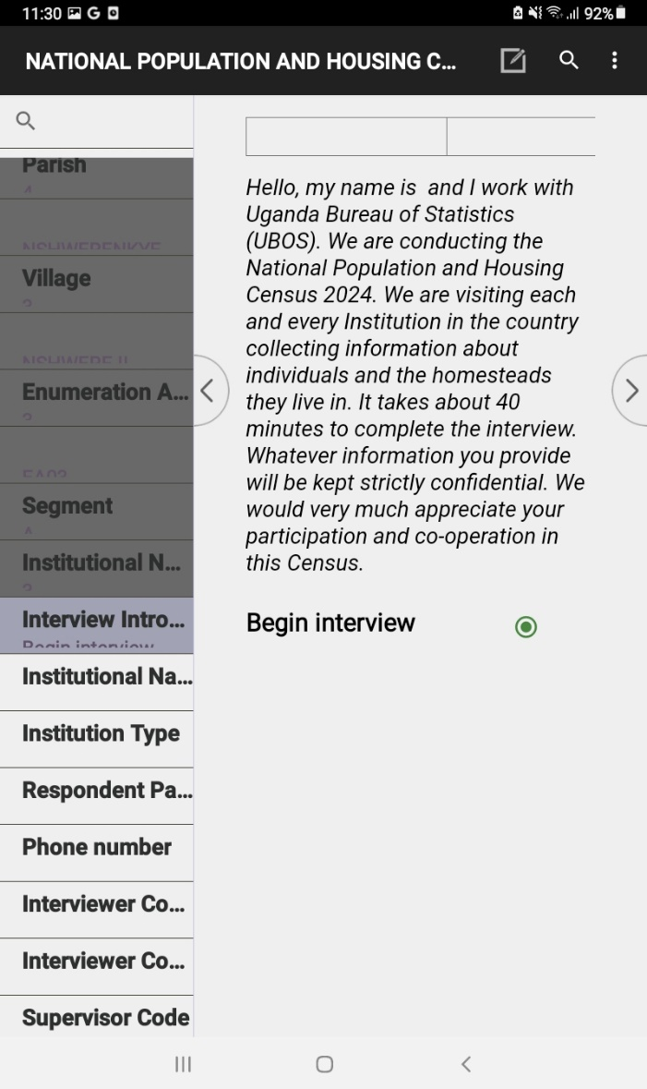
Institutional Questionnaire Interview (1/12)
Tap the “Begin Interview”
Tap the next screen arrow as circled in red

Slide 6
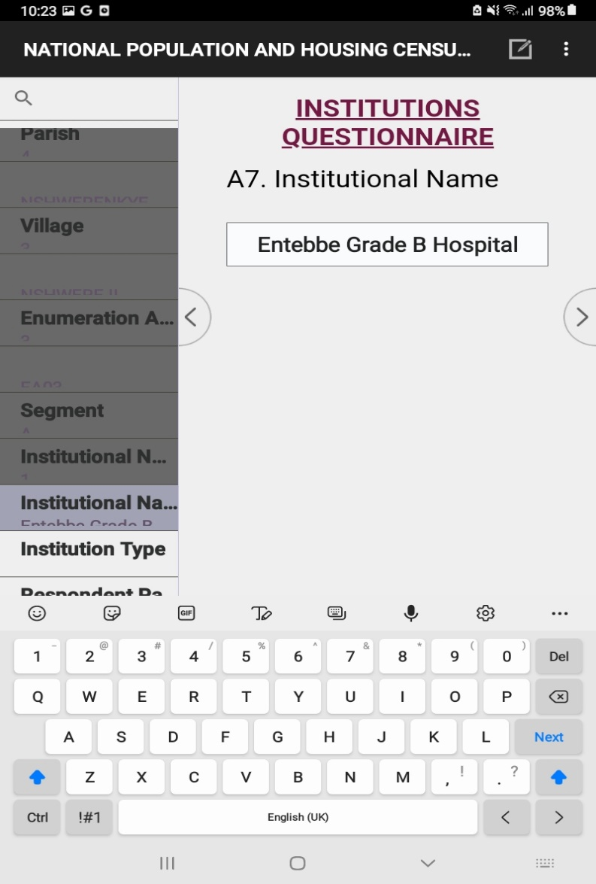

Institutional Questionnaire Interview (2/12)
Enter the details of the Institution

Slide 7
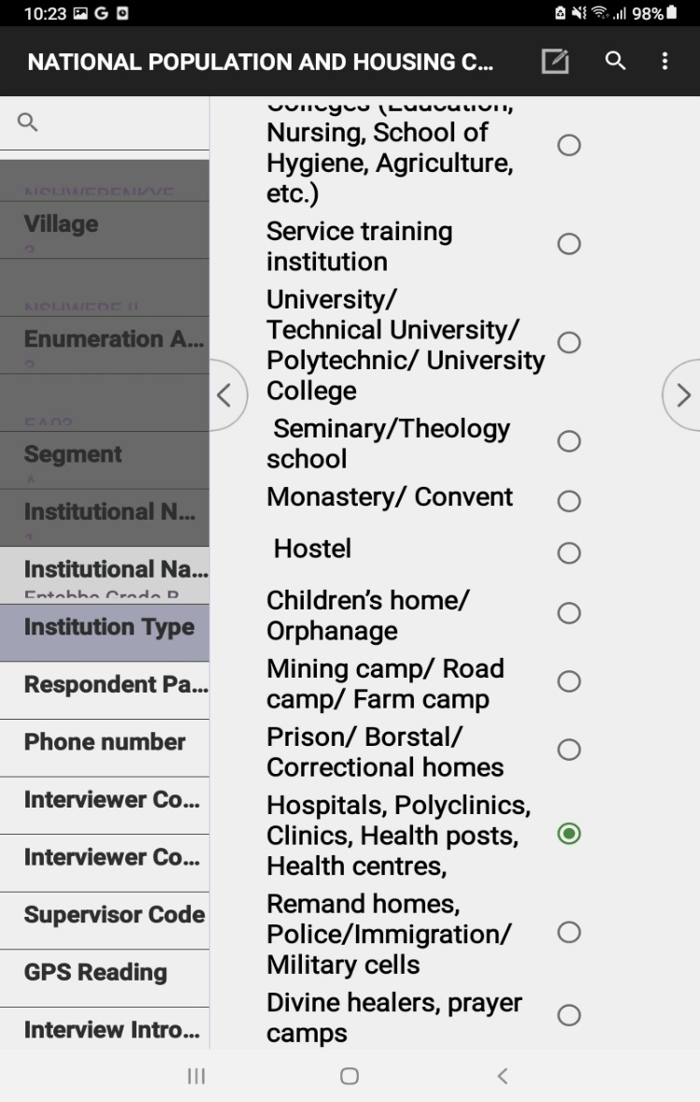

Institutional Questionnaire Interview (3/12)
Select the category of the institution
Go to the next screen

Slide 8
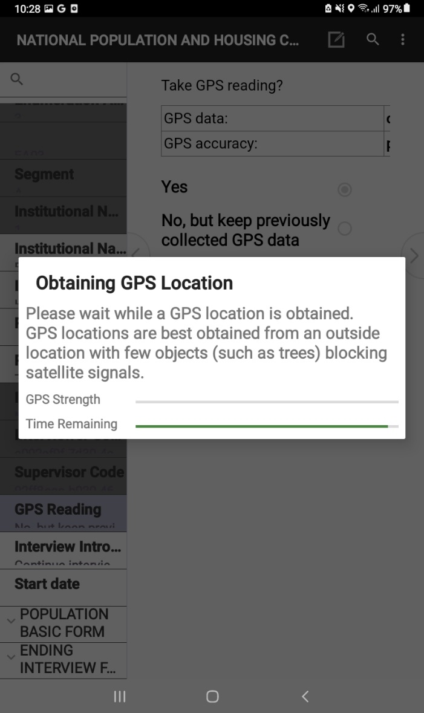
Institutional Questionnaire Interview (4/12)
Capture the GPS Coordinates
Go to the next screen

Slide 9
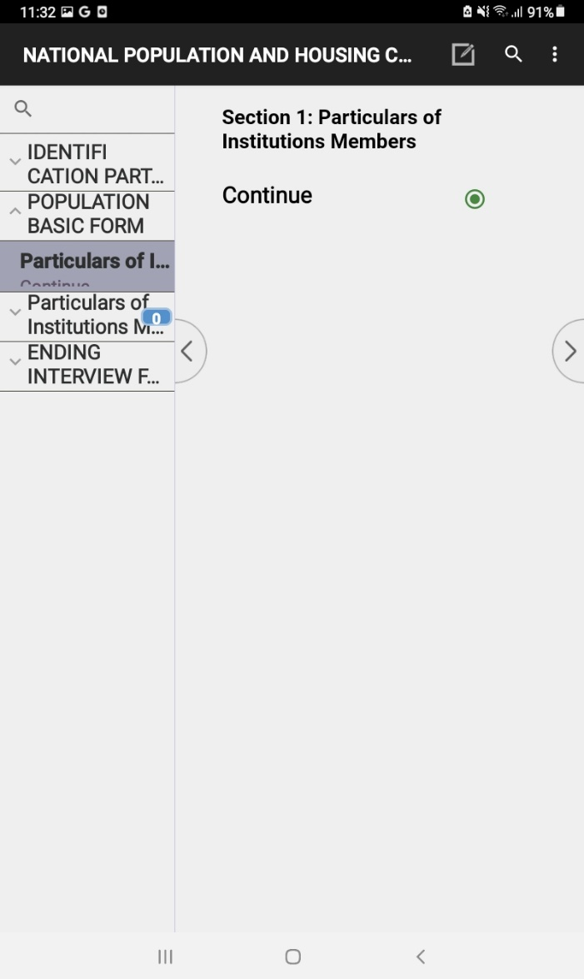
Institutional Questionnaire Interview (5/12)
Start Listing the members present in the institution
Go to the next screen

Slide 10
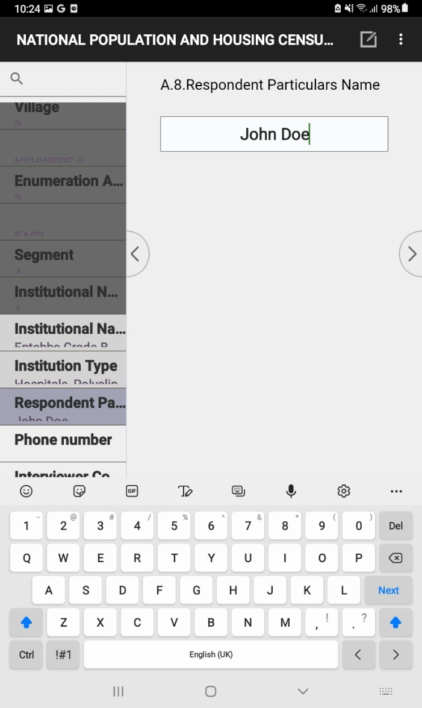
Institutional Questionnaire Interview (6/12)
Capture Details of each Member Present
Go to the next screen

Slide 11
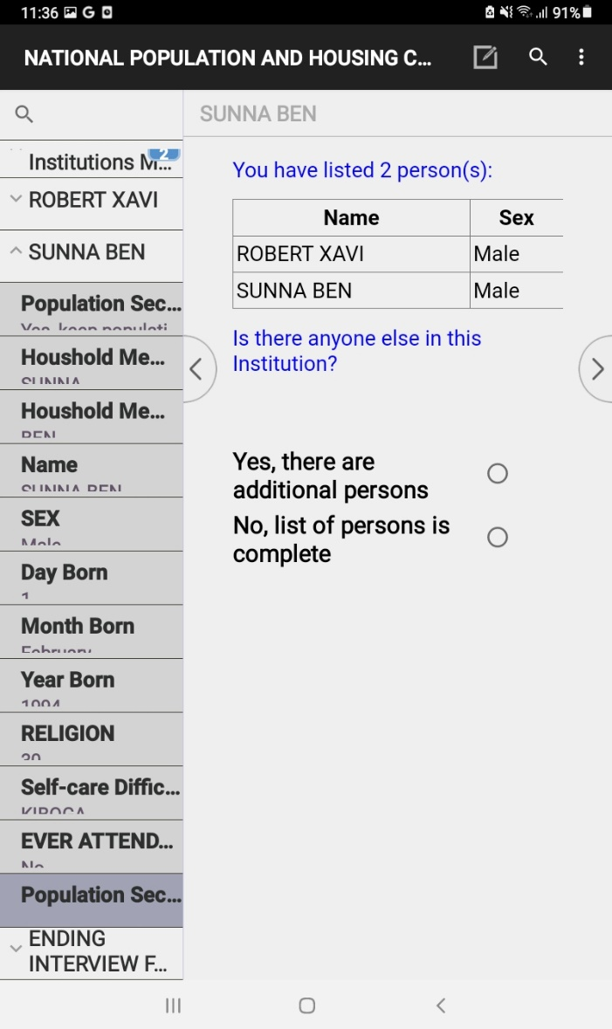
Institutional Questionnaire Interview (7/12)
Select the option “Yes, there are additional persons” to capture details of another person present in the institution or Select the “No, list of persons in complete”
Go to the next screen

Slide 12
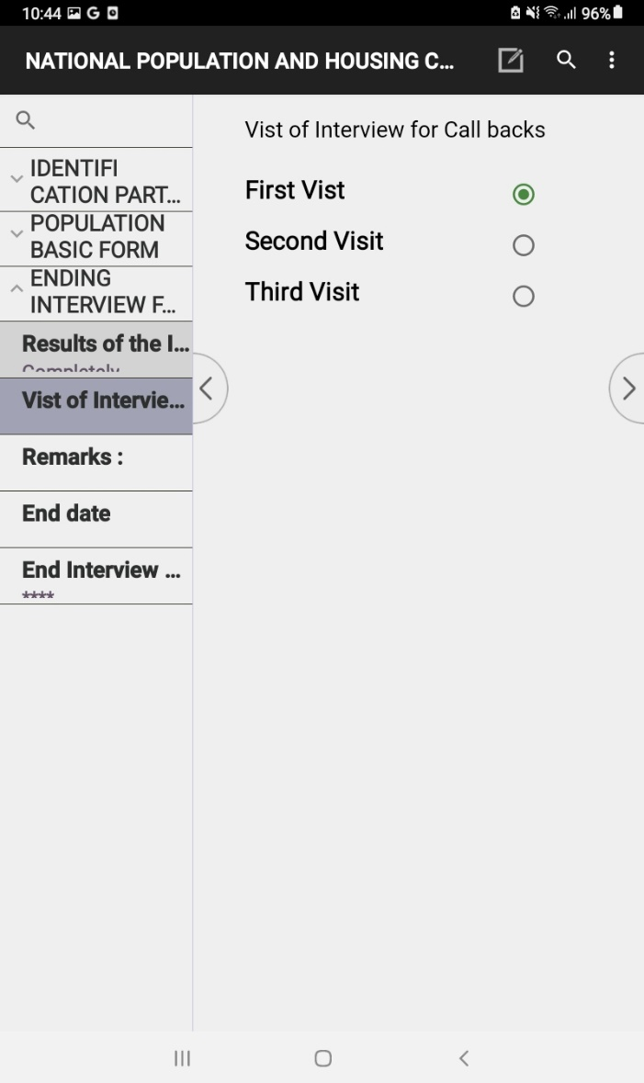
Institutional Questionnaire Interview (8/12)
Select the appropriate “Call back” option
Go to the next screen

Slide 13
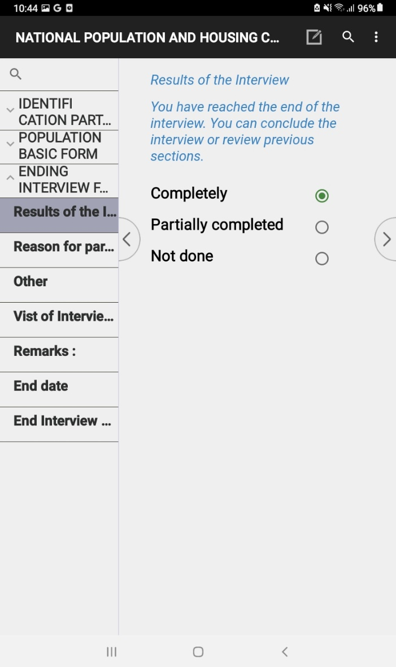
Institutional Questionnaire Interview (9/12)
Select the appropriate “Results of the Interview” option
Go to the next screen

Slide 14
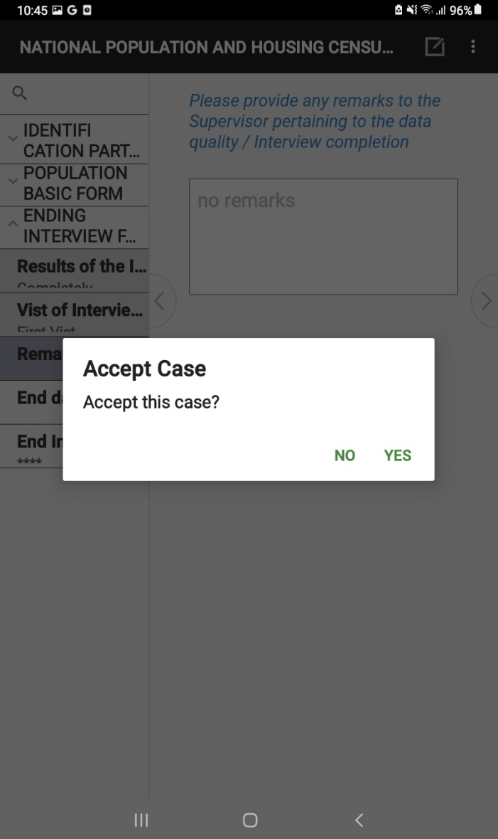
Institutional Questionnaire Interview (10/12)
On the Accept Case Dialog Screen, select yes to save the details of the institution
Go to the next screen

Slide 15
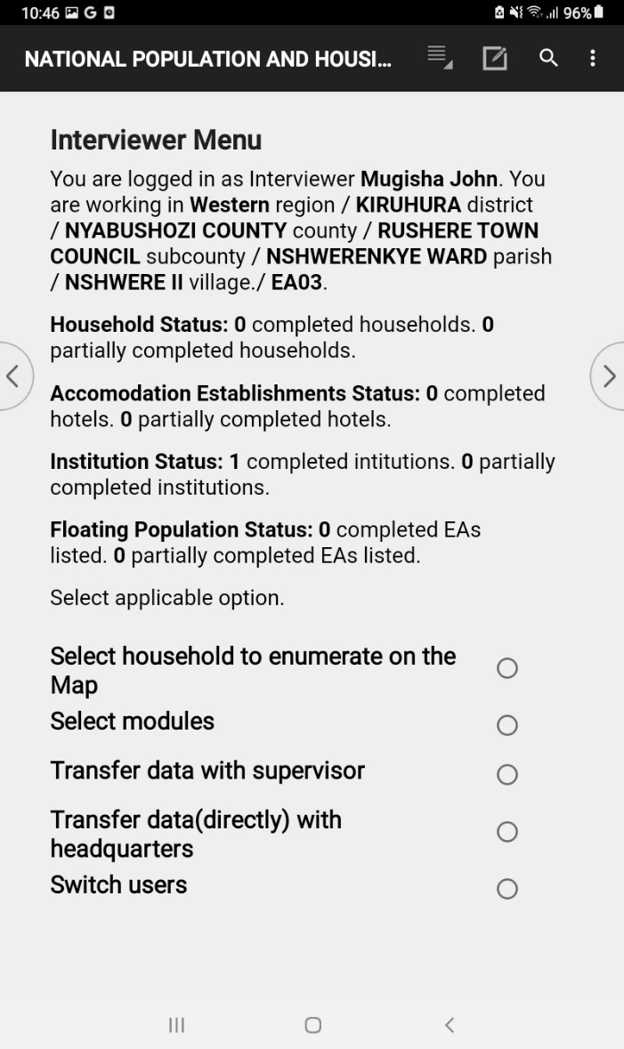
Institutional Questionnaire Interview (11/12)
Navigate back to the Interviewer Menu and verify the Institution status number. An increment means that the institution details have been saved.

Slide 16
Institutional Questionnaire Interview (12/12)
To add or modify an Institution, Tap the “Select modules”

Slide 17
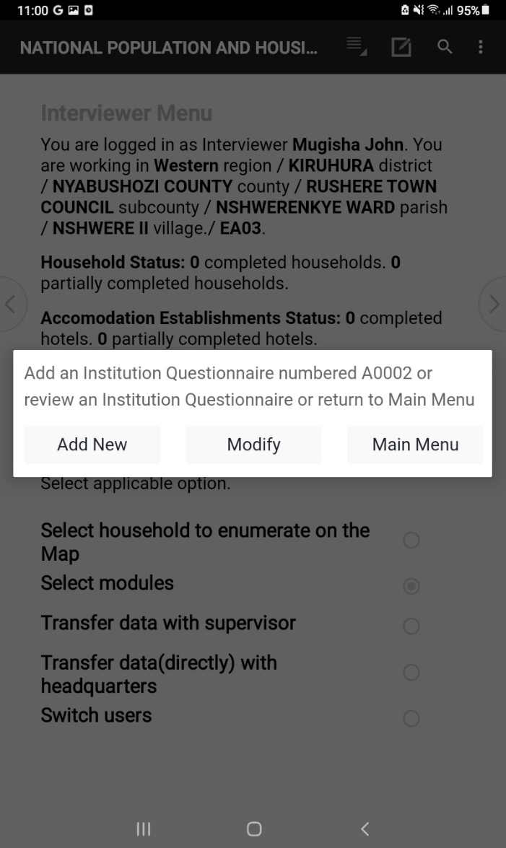
Add New or Modify existing Institution
On the Interviewer menu, Tap “Select Modules”
“Add New” – This adds details of a new Institution
“Modify” – Edit details of an already saved Institution
“Main Menu” – Return to the Interviewer Menu Screen

Slide 18


Thank You
Any Questions

