Slide 1

  COMMUNITY QUESTIONNAIRE
  NHPC 2024 TRAINING

Slide 2
INTRODUCTION
A community questionnaire is to be administered by the supervisor
It’s found under the supervisors MENU

Slide 3
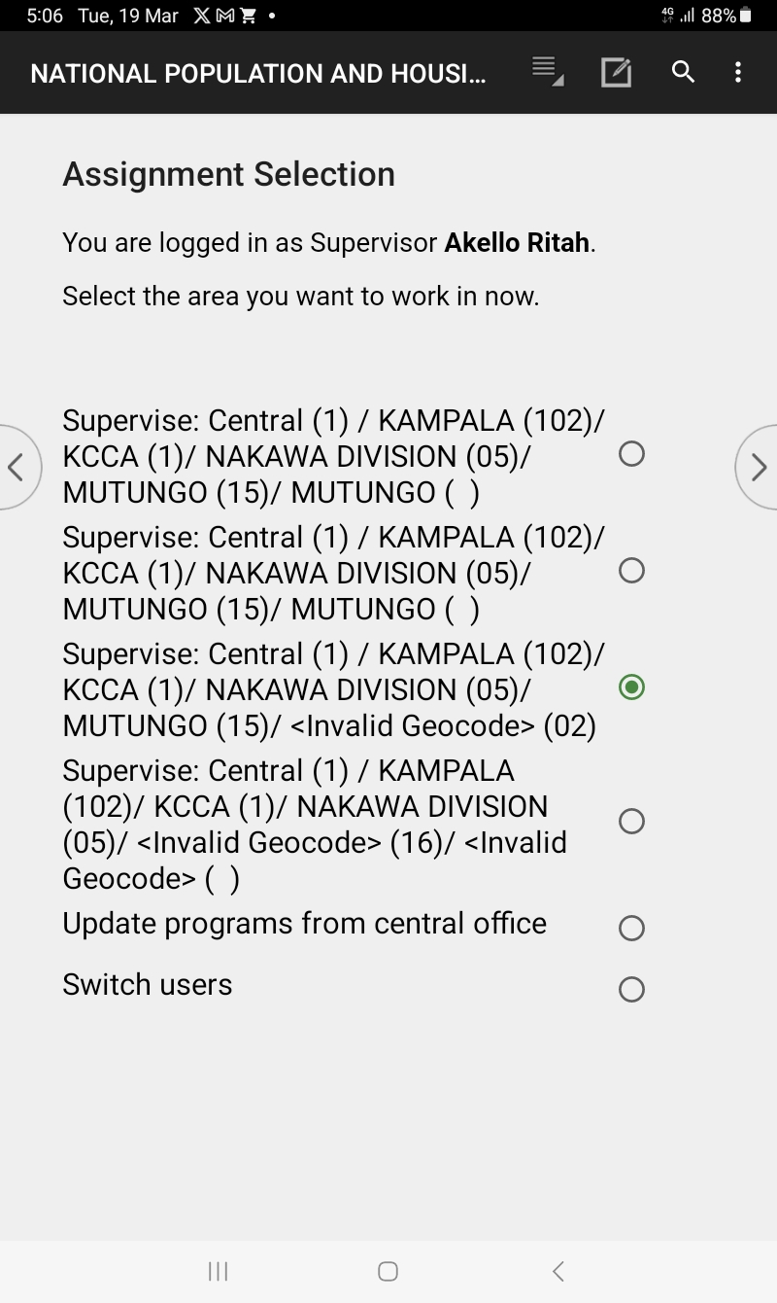
Supervisor Assignments Selection Menu
Select the Village to interview using a community questionnaire

Slide 4
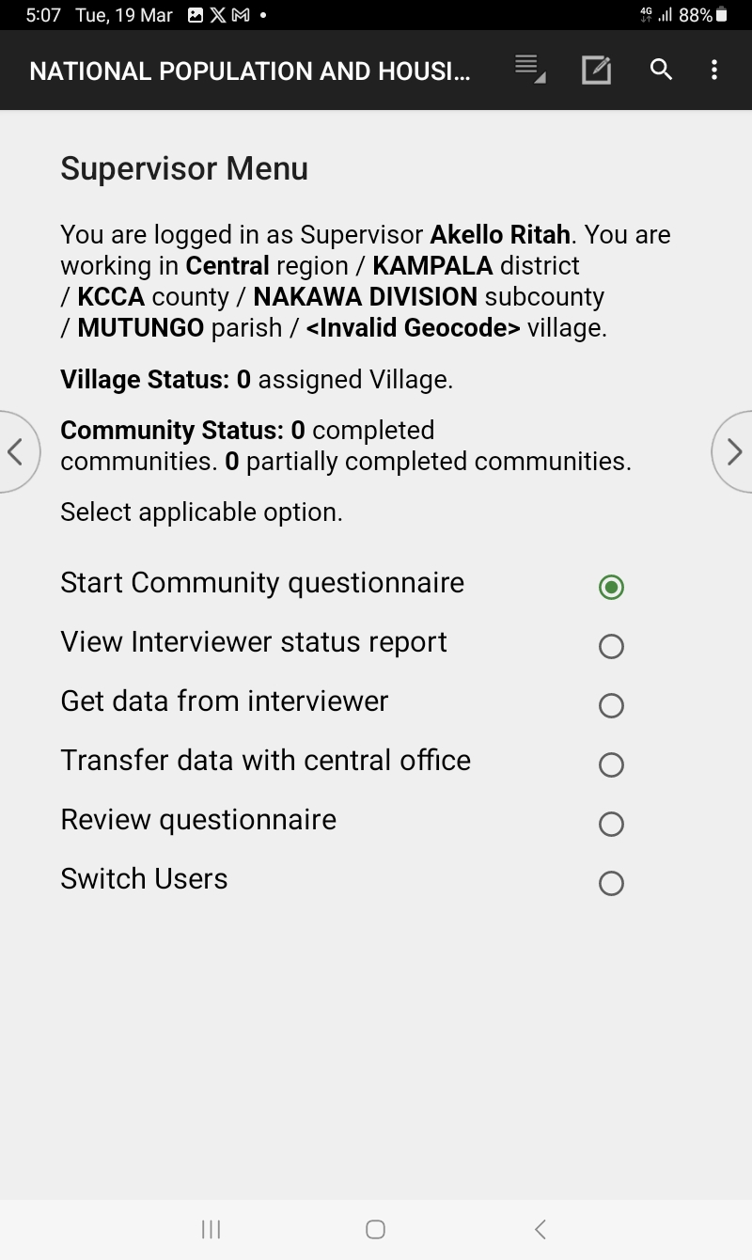
Supervisor Menu
Confirm the Village you have selected to work in
Select start community questionnaire to start interviewing

Slide 5
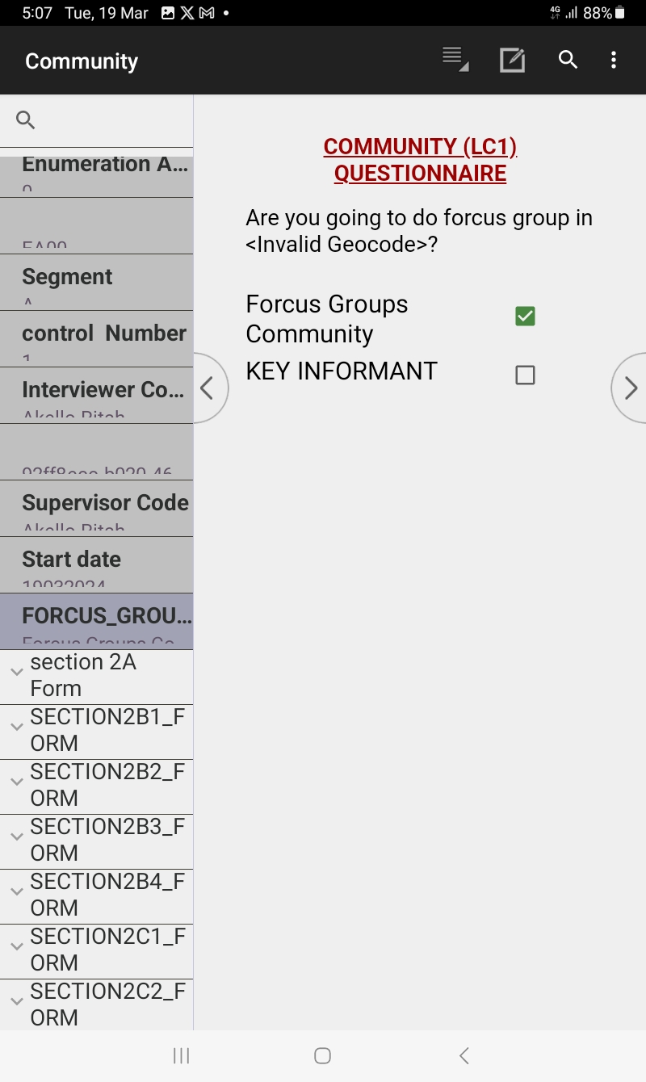
First community questionnaire screen
Select the choice of interviewing method.

Slide 6
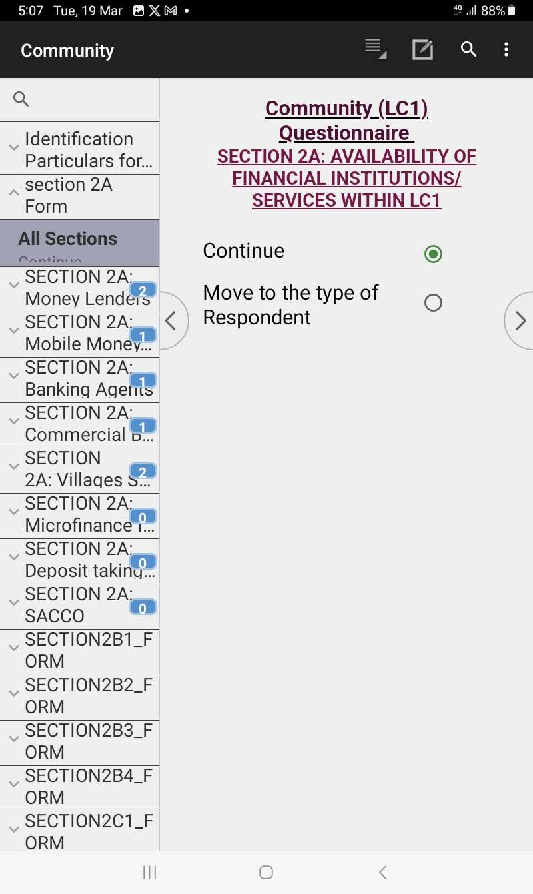
Continue interviewing in same institution type
Select continue if you still have financial institutions or move to the next institution type.

Slide 7
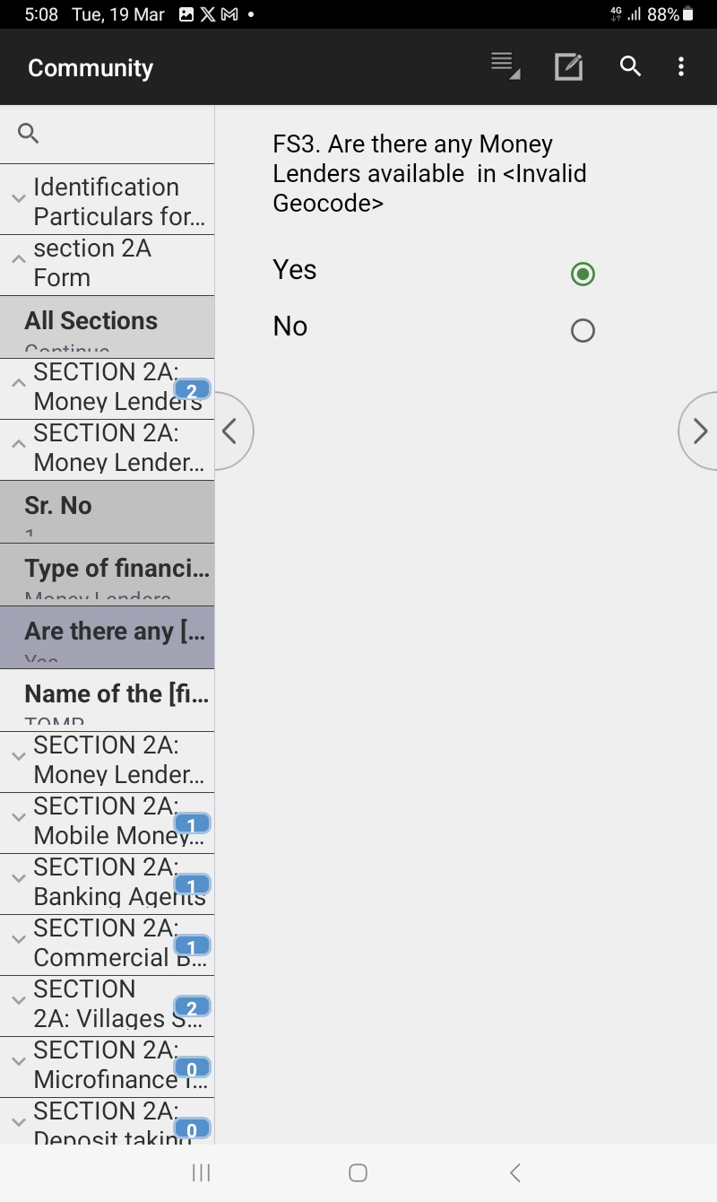
Ending one institution type interview
Select to end or continue the same institution type.

Slide 8
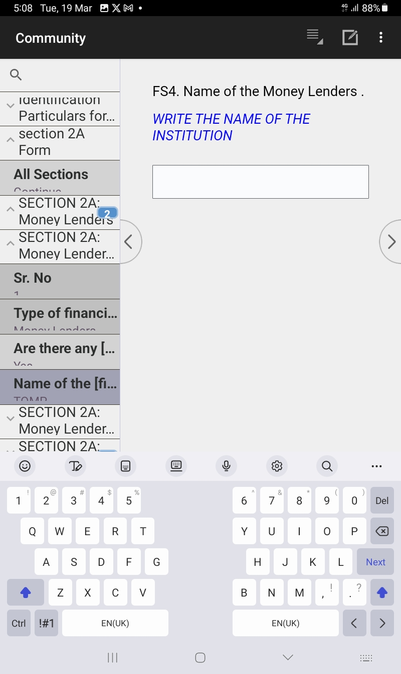
Start Money lender interviews next type of financial institution
Enter the name of the Money lender being interviewed.

Slide 9
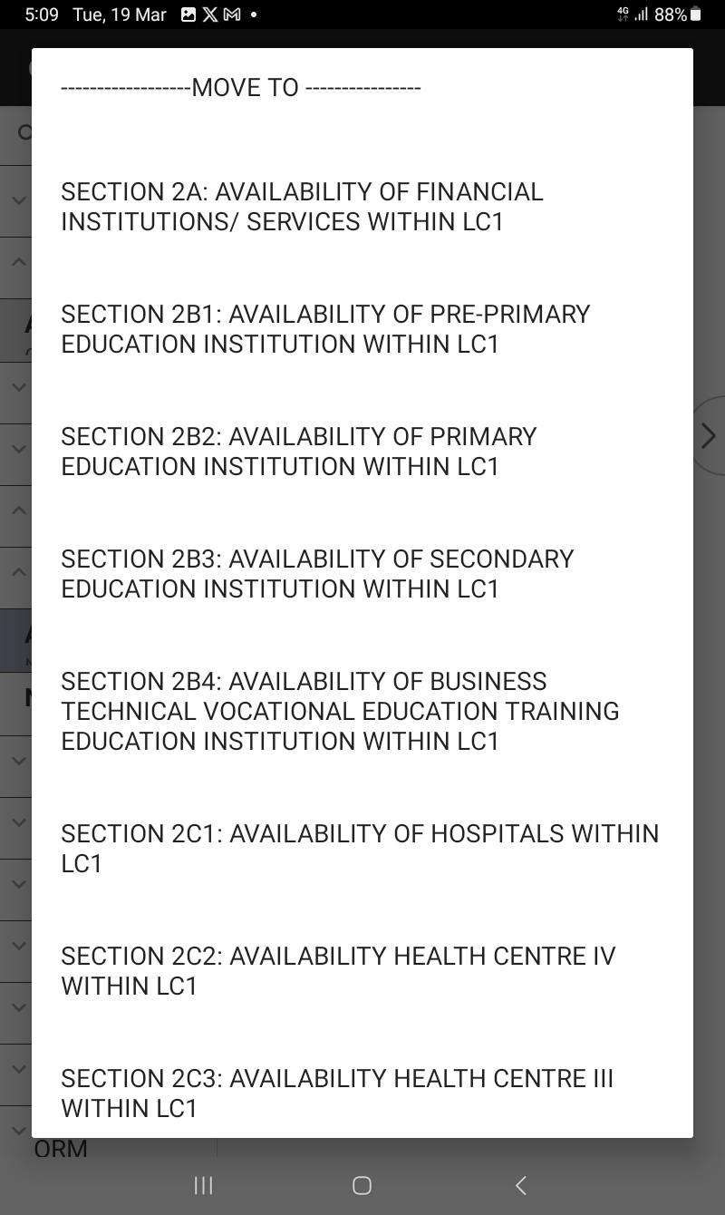
Switching Between different institution types
Tap on the five horizontal line to access different modules of the questionnaire

Slide 10
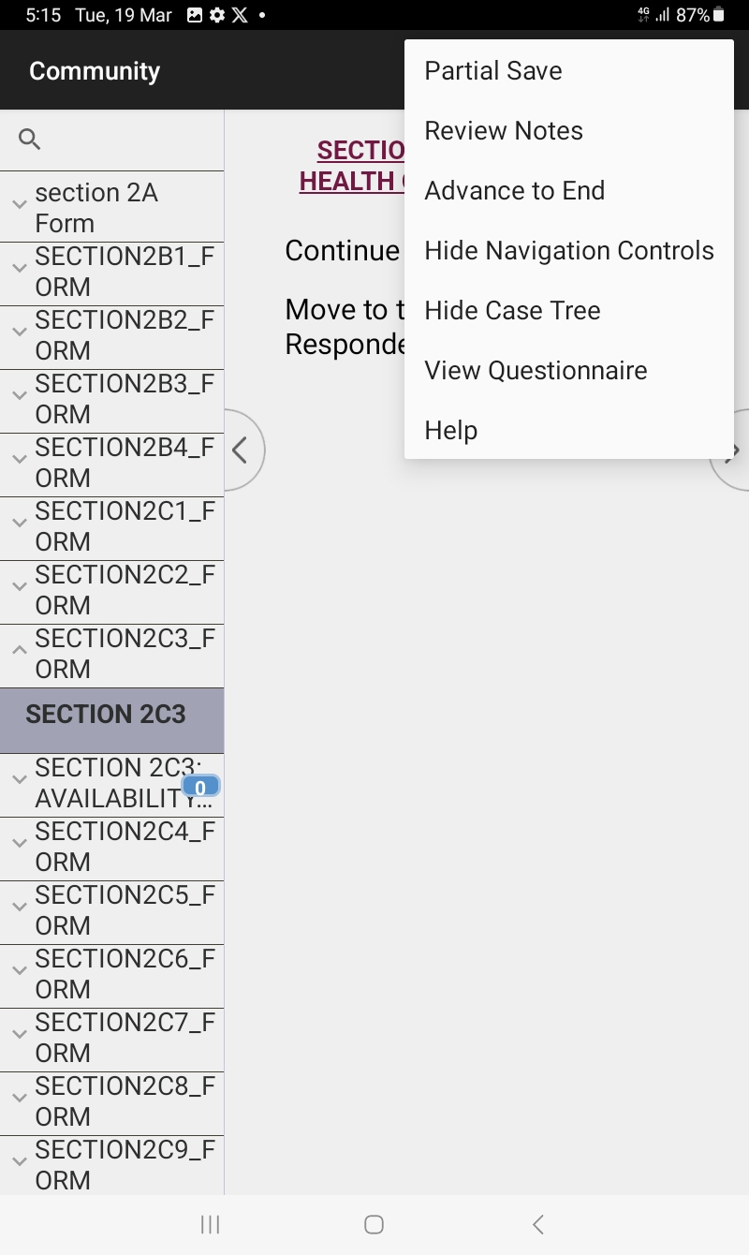
Other CAPI options available
Select the three dots on top right hand corner of your tablet and chose any of the options available .

Slide 11
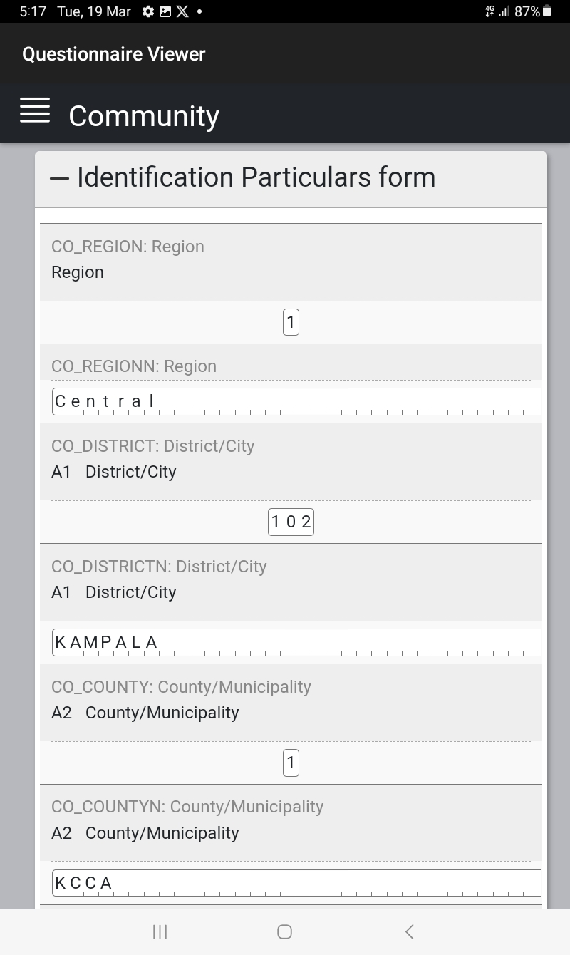
View questionnaire option six
Select on view questionnaires to view your filled in questionnaire in form of a PDF.

Slide 12
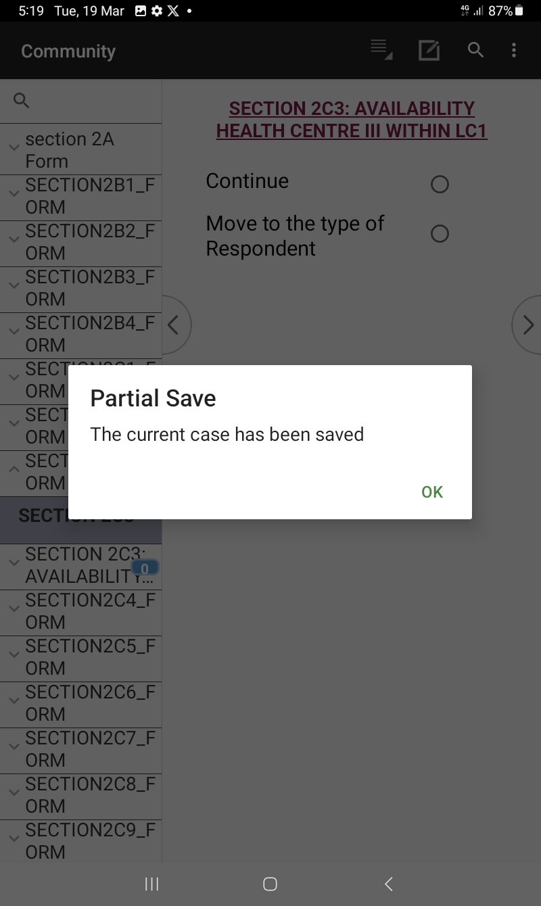
View questionnaire option six
Selecting partial save option, to partially save your questionnaire

Slide 13
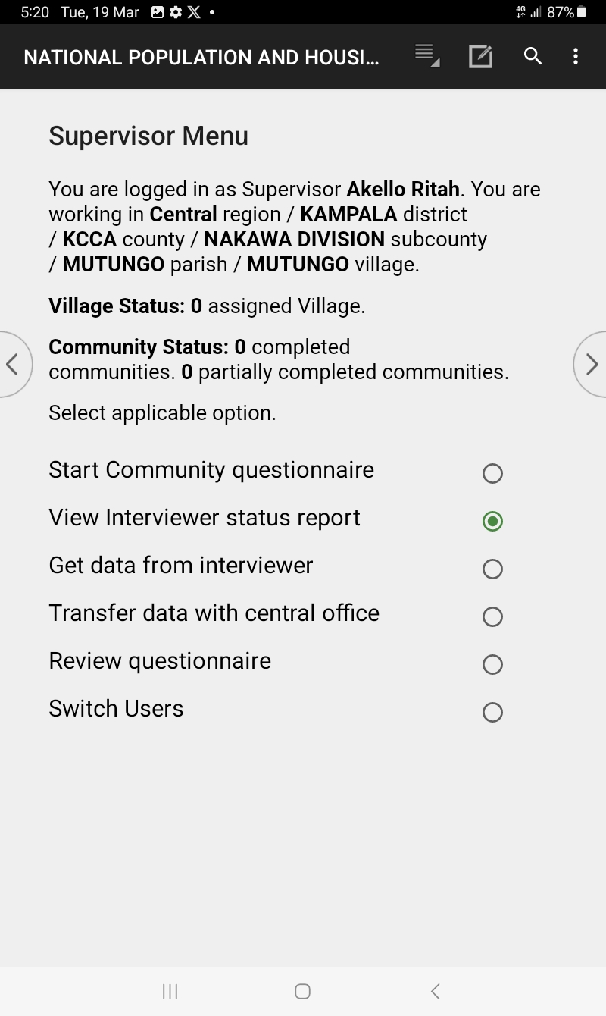
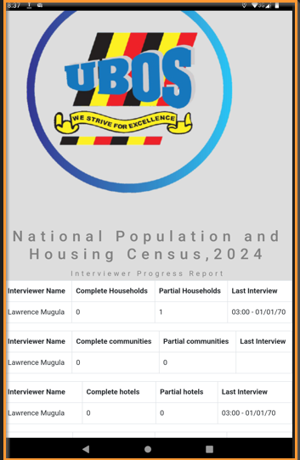
Viewing Interview status on supervisor menu
Select view interviewer status report to see what you have so far done.

Slide 14


Thank You
Any Questions

